Slide 1

Density-Based and other Clustering Methods
CS240B lecture notes by C. Zaniolo.
Slides based on those by J. Han www.cs.uiuc.edu/~hanj
and Martin Pfeifle www.dbs.informatik.uni-muenchen.de

Slide 2
Cluster Analysis
What is Cluster Analysis?
Types of Data in Cluster Analysis
A Categorization of Major Clustering Methods
Partitioning Methods
Hierarchical Methods
Density-Based Methods
Many other methods
  Grid-Based Methods
  Model-Based Methods
  Methods for High-Dimensional Data
  Constraint-Based Clustering
Clustering data streams
Summary

Slide 3
Density-Based Clustering Methods
Clustering based on density (local cluster criterion), such as density-connected points
Major features:
  Discover clusters of arbitrary shape
  Handle noise
  One scan
  Need density parameters as termination condition
Several interesting studies:
  DBSCAN: Ester, et al. (KDD’96)
  OPTICS: Ankerst, et al (SIGMOD’99).
  DENCLUE: Hinneburg & D. Keim (KDD’98)
  CLIQUE: Agrawal, et al. (SIGMOD’98) (more grid-based)

Slide 4
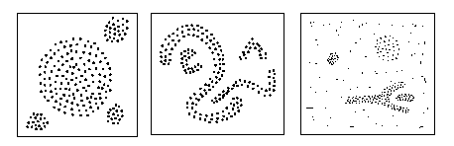
Examples
Clustering based on density (local cluster criterion), such as density-connected points
Each cluster has a considerable higher density of points than outside of the cluster

Slide 5
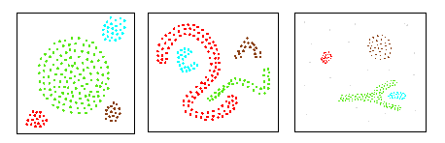
DBSCAN
Application examples:
Population density, Spreading of Deseases, Trajectory tracing

Slide 6
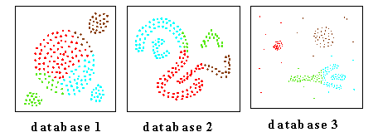
Compare to Centroid-Based Algorithms
CLARANS:
DBSCAN:

Slide 7
DBSCAN
DBSCAN is a density-based algorithm.
  Density = number of points within a specified radius (Eps)
  A point is a core point if it has more than a specified number of points (MinPts) within Eps
    These are points that are at the interior of a cluster
  A border point has fewer than MinPts within Eps, but is in the neighborhood of a core point
  A noise point is any point that is not a core point or a border point.

Slide 8

DBSCAN: Core, Border, and Noise Points

Slide 9
Density-Reachable and Density-Connected
(w.r.t. Eps, MinPts)
Let p be a core point, then every point in its Eps neighborhood is said to be directly density-reachable from p.
A point p is density-reachable from a point core point q if there is a chain of points p₁, …, p_{n}, p₁ = q, p_{n} = p
A point p is density-connected to a point q if there is a point o such that both, p and q are density-reachable from o
p
p₁
q
p
q
o

Slide 10
DBSCAN: The Algorithm
Eps and MinPts
Let ClusterCount=0. For every point p:
  If p it is not a core point, assign a null label to it [e.g., zero]
  If p is a core point, a new cluster is formed
  [with label ClusterCount:= ClusterCount+1]
  Then find all points density-reachable form p and classify them in the cluster.
  [Reassign the zero labels but not the others]
  Repeat this process until all of the points have been visited.
Since all the zero labels of border points have been reassigned in 2, the remaining points with zero label are noise.

Slide 11

DBSCAN Complexity Comparison
Time Complexity | A single neighborhood query | DBSCAN
Without index | O(n) | O(n²)
R*-tree | O(log n) | O(n log n)
The height of a R*-Tree is O(log n) in the worst case
A query with a “small” region traverses only a limited number of paths in the R*-Tree
With R*-tree performance compare well with other clustering algorithms

Slide 12
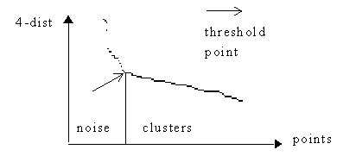
Heuristics for Eps and Minpts
K-dist(p): distance from p to k^{th} nearest neighbor
List points by k-dist (p)
Minpts: k>4 no significant difference, but more computation, thus set k = 4.

Slide 13


When DBSCAN Works Well
Original Points
Clusters
Resistant to Noise
Can handle clusters of different shapes and sizes

Slide 14

Too Large an EPS
Original Points
Point types: core, border and noise
Eps = 10, MinPts = 4

Slide 15
Problem of DBSCAN
Different clusters may have very different densities
Density as hills represented by level curves
Clusters may be in hierarchies

Slide 16
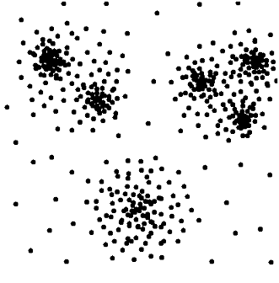
Clustering
Clustering
  Efficiently grouping the database into sub-groups (clusters) such that
    similarity within clusters maximized
    similarity between clusters minimized
  Flat Clustering
  one level of clusters
  Hierarchical Clustering
  nested clusters
  e.g. density-based clustering algorithm
  DBSCAN [KDD 96]
  e.g. density-based clustering algorithm
  OPTICS [SIGMOD 99]

Slide 17
Optics
Hierarchical density-based clustering.
Deals with different densities
Two basic steps:
  Map reachability function between points
  Contstruct clusters by assigning most mutually reachable points to clusters.

Slide 18
OPTICS (ε > Eps)
ε
For each point p we can determine its
Core-distance, “smallest distance such that o is a core object”. If that distance is larger than ε then this will never a core point.
Reachability distance for the other points in the ε−neighborhood of o. These points can become directly density-reachable from p for the right value of Eps.
MinPts = 5
ε
p
o
core-distance(o)
reachability-distance(p,o)
All these points are then added to a seed list where they sorted according to their least distance w.r.t. the previous core points.

Slide 19
The Algorithm OPTICS
Basic data structure: controlList
  Memorize shortest reachability distances seen so far (“distance of a jump to that point”)
  Visit each point
  Make always a shortest jump
Output:
  order of points
  core-distance of points
  reachability-distance of points

Slide 20
OPTICS Algorithm
Example Database (2-dimensional, 16 points)
= 44, MinPts = 3
ε
reach
∞
E
G
D
H
F
C
44
B
K
M
N
A
I
L
J
P
R
seedlist:

Slide 21
OPTICS Algorithm
Example Database (2-dimensional, 16 points)
= 44, MinPts = 3
ε
reach
∞
∞
E
E
G
D
G
D
H
H
F
F
C
C
44
44
B
B
core-
distance
K
K
M
M
N
N
I
A
I
A
L
L
P
J
P
J
A
R
ε
R
seedlist:
(B,40) (I, 40)

Slide 22
OPTICS Algorithm
Example Database (2-dimensional, 16 points)
= 44, MinPts = 3
ε
reach
∞
∞
E
G
D
H
F
C
44
44
B
K
M
N
A
I
L
J
P
A
B
R
seedlist: (I, 40) (C, 40)

Slide 23
OPTICS Algorithm
Example Database (2-dimensional, 16 points)
= 44, MinPts = 3
ε
reach
∞
∞
E
G
D
H
F
C
44
44
B
K
M
N
A
I
L
J
P
A
B
I
R
seedlist: (J, 20) (K, 20) (L, 31) (C, 40) (M, 40) (R, 43)

Slide 24
OPTICS Algorithm
Example Database (2-dimensional, 16 points)
= 44, MinPts = 3
ε
reach
∞
∞
E
G
D
H
F
C
44
44
B
K
M
N
A
I
L
J
P
A
B
I
J
R
seedlist: (L, 19) (K, 20) (R, 21) (M, 30) (P, 31) (C, 40)

Slide 25
OPTICS Algorithm
Example Database (2-dimensional, 16 points)
= 44, MinPts = 3
ε
reach
∞
∞
E
G
D
H
F
C
44
44
B
K
M
N
…
A
I
L
J
P
A
B
I
J
L
R
seedlist: (M, 18) (K, 18) (R, 20) (P, 21) (N, 35) (C, 40)

Slide 26
OPTICS Algorithm
Example Database (2-dimensional, 16 points)
= 44, MinPts = 3
ε
reach
∞
E
G
D
H
F
C
44
B
K
M
N
A
I
L
J
P
A
B
I
J
L
M
K
N
R
P
C
D
F
G
E
H
R
seedlist: -

Slide 27
OPTICS Algorithm
Example Database (2-dimensional, 16 points)
= 44, MinPts = 3
ε
reach
∞
E
G
D
H
F
C
44
B
K
M
N
A
I
L
J
P
A
B
I
J
L
M
K
N
R
P
C
D
F
G
E
H
R
seedlist: -

Slide 28


‘
“
One Clusters
Three Clusters
undefined
“
‘
Cluster-order
of the objects

Slide 29
Other Density-Based Methods: Denclue
Uses grid cells but only keeps information about grid cells that do actually contain data points and manages these cells in a tree-based access structure
Influence function: describes the impact of a data point within its neighborhood
Overall density of the data space can be calculated as the sum of the influence function of all data points
Clusters can be determined mathematically by identifying density attractors
Density attractors are local maximal of the overall density function

Slide 30
Cluster Analysis
What is Cluster Analysis?
Types of Data in Cluster Analysis
A Categorization of Major Clustering Methods
Partitioning Methods
Hierarchical Methods
Density-Based Methods
Many other methods
  Grid-Based Methods
  Model-Based Methods
  Methods for High-Dimensional Data
  Constraint-Based Clustering
Outlier Analysis
Clustering data streams
Summary

Slide 31
Grid-Based Clustering Method
Using multi-resolution grid data structure
Several interesting methods
  STING (a STatistical INformation Grid approach) by Wang, Yang and Muntz (1997)
  WaveCluster by Sheikholeslami, Chatterjee, and Zhang (VLDB’98)
    A multi-resolution clustering approach using wavelet method
  CLIQUE: Agrawal, et al. (SIGMOD’98)
    On high-dimensional data (thus put in the section of clustering high-dimensional data

Slide 32
WaveCluster: Clustering by Wavelet Analysis (1998)
WaveCluster: Clustering by Wavelet Analysis (1998)Sheikholeslami, Chatterjee, and Zhang (VLDB’98)
  A multi-resolution clustering approach which applies wavelet transform to the feature space
Expectation Minimization— A popular iterative refinement algorithm
  An extension to k-means
Conceptual Clustering: COBWEB (Fisher’87)
  Creates a hierarchical clustering in the form of a classification tree

Slide 33
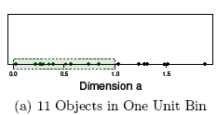
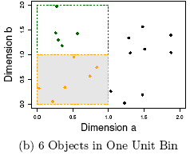
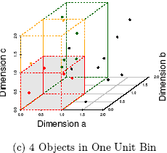
The Curse of Dimensionality
(graphs adapted from Parsons et al. KDD Explorations 2004)
Data in only one dimension is relatively packed
Adding a dimension “stretch” the points across that dimension, making them further apart
Adding more dimensions will make the points further apart—high dimensional data is extremely sparse
Distance measure becomes meaningless—due to equi-distance

Slide 34
CLIQUE (Clustering In QUEst)
Agrawal, Gehrke, Gunopulos, Raghavan (SIGMOD’98)
Automatically identifying subspaces of a high dimensional data space that allow better clustering than original space
CLIQUE can be considered as both density-based and grid-based

Slide 35
Cluster Analysis
What is Cluster Analysis?
Types of Data in Cluster Analysis
A Categorization of Major Clustering Methods
Partitioning Methods
Hierarchical Methods
Density-Based Methods
Many other methods
  Grid-Based Methods
  Model-Based Methods
  Methods for High-Dimensional Data
  Constraint-Based Clustering
Clustering data streams

Slide 36
DBSCAN in Stream Mill
Visit a point never visited before and retrieve all points density-reachable from p wrt Eps and MinPts.
  If p is a core point, a cluster is formed. Then find all points density-reachable form p and classify them in the cluster
aggregate dbscan(iX int, iY int, Flag Int, minPt int, eps int): (AnInt Int) {
TABLE closepnts(X2 int, Y2 int) hash(X2, Y2) memory;
TABLE todo(X3 int, Y3 int, C2 Int) hash(X3, Y3) memory;
table cpCnt(cnt int) memory;
initialize: iterate: {insert into closepnts select X1, Y1, C1 from points
where sqrt((X1-iX)*(X1-iX) + (Y1-iY)*(Y1-iY)) < eps; /*eps is max distance*/
insert into cpCnt select count(C2) from closepnts;
update clusterno set Cno= Cno+1 /*new cluster number*/
where Flag=0 and minPt < (select cnt from cpCnt); /*density condition*/
update points set C1 = (select Cno from clusterno)
where points.C1=0
and exists (select S.X1 from closepnts as S
where points.X1=S.X2 and points.Y1=S.Y2)
and minPt < (select cnt from cpCnt); /*density condition */

Slide 37
DBSCAN: The Algorithm cont. from previous page
  Then find all points density-reachable form p and classify them in the cluster. Then for those that are core points find all the points density-reachable from them, and so on…
  /* Assign these neighboring points to this cluster */
  . . . insert into todo /* points to be expanded*/
  select C.X2, C.Y2
  from closepnts as C
  where SQLCODE=0 AND C.C2=0
  AND NOT EXISTS (select X3, Y3 from todo as t
  where C.X2=t.X3 and C.Y2=t.Y3);
  delete from closepnts;
  delete from cpCnt;
  select dbscan(X3, Y3, 1, minPt, eps) /* recursive call*/
  from todo, points
  where X1 = X3 and Y1=Y3;
  delete from todo /* end of initialize:iterate*/ }
  terminate: { /*insert into RETURN values(1);*/ }
  }; /*end dbscan*/

Slide 38
External Tables
TABLE points (X1 int, Y1 int, C1 Int) memory;
/*This is the table containing the points*/
/*initially C1=0*; at the end the actual cluster#*/
TABLE clusterno(Cno Int) memory;
/*the first cluster will be #1 */

Slide 39
Clustering Data Streams
The data stream is partitioned into windows that are clustered independently
DBSCAN in Stream Mill
  Concept shift detection: by detecting changes in number of clusters or their population
Incremental clustering—a research area

Slide 40
Data Stream Clustering: Bibliography
Liadan O'Callaghan, Adam Meyerson, Rajeev Motwani, Nina Mishra, Sudipto Guha: Streaming-Data Algorithms for High-Quality Clustering. ICDE 2002: 685+
Sudipto Guha, Adam Meyerson, Nina Mishra, Rajeev Motwani, Liadan O'Callaghan: Clustering Data Streams: Theory and Practice. IEEE Trans. Knowl. Data Eng. 15(3): 515-528 (2003)
C. Aggarwal, J. Han, J. Wang, P. S. Yu. A Framework for Clustering Data Streams, VLDB'03
C. Aggarwal, J. Han, J. Wang, and P. S. Yu. A Framework for Projected Clustering of High Dimensional Data Streams, VLDB'04.

